Slide 1
The Project Management Context

Slide 2
Projects Cannot Be Run in Isolation
Use systems thinking:
Taking a holistic view of carrying out projects within the context of the organization
Senior managers must make sure projects continue to support current business needs

Slide 3
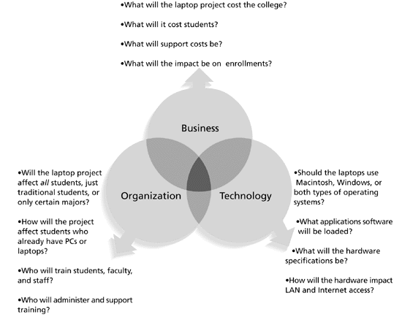
Three Sphere Model for Systems Management

Slide 4
Understanding Organizations
Structural frame: roles and responsibilities, coordination and control.
Organization charts help define this frame.
Human resources frame: harmony between needs of the organization and people.
Political frame: organizations are coalitions of certain individuals and interest groups. Conflict and power are key issues.
Symbolic frame:
related to events.
Culture is important.

Slide 5
Organizational Structures
Functional: functional managers report to the CEO
Project: program managers report to the CEO
Matrix: middle ground between functional and project structures; personnel often report to two or more bosses; structure can be weak, balanced, or strong matrix

Slide 6
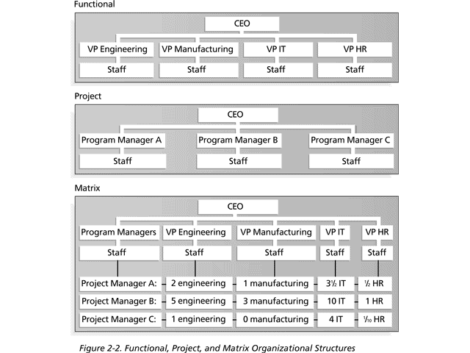
Functional, Project, and Matrix Organizational Structures

Slide 7
Organizational Culture
Organizational culture is a set of shared:
Assumptions
Values
behaviors
many companies’ problems are not the structure or staff, but the culture

Slide 8
Stakeholder Management
Need to identify, understand and manage relationships with all project stakeholders
Senior executives/top management are very important stakeholders

Slide 9
The Importance of Top Management Commitment
People in top management positions are key stakeholders in projects
level of commitment and support
Without top management commitment, many projects will fail
senior manager called a champion who acts as a key proponent for a project

Slide 10
How Top Management Can Help Project Managers
Providing adequate resources
Approving unique project needs in a timely manner
Obtaining cooperation from other parts of the organization
Mentoring and coaching on leadership issues

Slide 11
Project Phases and the Project Life Cycle
A project life cycle is a collection of project phases that defines:
What work will be performed in each phase
What deliverables will be produced and when
Who is involved in each phase
How management will control and approve work produced in each phase
A deliverable is a product or service produced or provided as part of a project

Slide 12
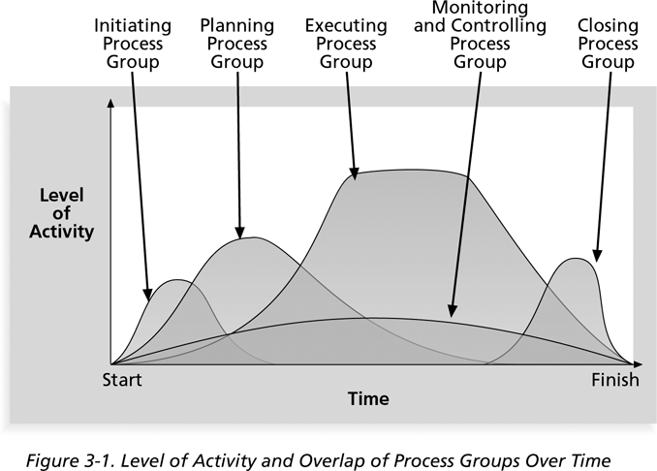
Life cycle through phases

Slide 13
More on Project Phases
In early phases of a project life cycle:
Resource needs are usually lowest
The level of uncertainty (risk) is highest
Project stakeholders have the greatest opportunity to influence the project
In middle phases of a project life cycle:
The certainty of completing a project improves
More resources are needed
The final phase of a project life cycle focuses on:
project requirements are met
The sponsor approving completion of the project

Slide 14
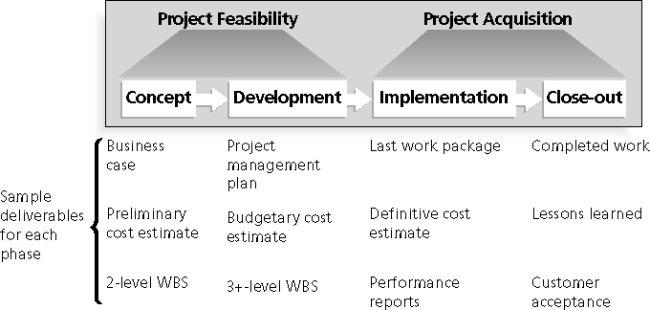
Phases of the Traditional Project Life Cycle

Slide 15
The Importance of Project Phases and Management Reviews
A project should successfully pass through each of the project phases in order to continue on to the next
Management reviews or phase exits or kill points, should occur after each phase to evaluate the project’s progress, likely success, and continued compatibility with organizational goals

Slide 16
Phases Exit Example
"The real improvement that I saw was in our ability to in the words of Thomas Edison know when to stop beating a dead horse.…Edison's key to success was that he failed fairly often; (Phase Exits) but as he said, he could recognize a dead horse before it started to smell...
With new technology we ride dead horses failing projects a long time before we give up. But what we are seeing now is that we are able to get off them; able to reduce cost overrun and time overrun. That's where the major impact came on the success rate.”*

Slide 17
The Context of Projects
projects can be very diverse in terms of
Size
Complexity – technology projects
products produced
resource requirements

Slide 18
Recent Trends Affecting Project Management
Globalization:
lower trade
political barriers
digital revolution
Helps interact instantaneously billions of other people across the planet

Slide 19
Recent Trends Affecting Project Management
Outsourcing
outsourcing is when an organization acquires goods and/or sources from an outside source; offshoring is sometimes used to describe outsourcing from another country

Slide 20
Recent Trends Affecting Project Management
Virtual teams: a virtual team is a group of individuals who work across time and space using communication technologies

Slide 21
Important Issues and Suggestions Related to Globalization
Issues
Communications
Trust
Common work practices
Tools
Suggestions
Employ greater project discipline
Think global but act local
Keep project momentum going
Use newer tools and technology

Slide 22
Virtual Teams Advantages
Increasing competiveness and responsiveness by having a team of workers available 24/7
Lowering costs because many virtual workers do not require office space or support beyond their home offices
More expertise and flexibility by having team members from across the globe working any time of day or night
Eliminating
fixed office hours
travel to work

